Slide 1
Facebook Dataset analysis
By- Arsh Abel Kumar

Slide 2
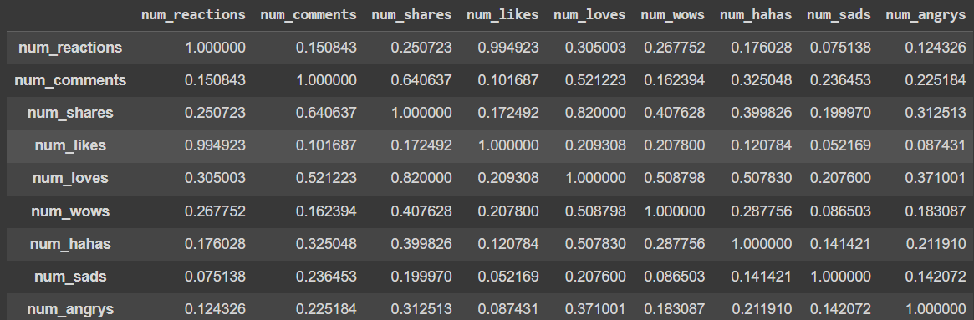
Correlation between various metrics
Firstly, we observe the correlation between various metrics of the dataset.

Slide 3
From the above matrix, we can conclude that, all the correlations are in the positive direction and their strength can be observed as:
The correlations having value closer to 1 are considered as strong, whereas the correlations having value closer to 0 are considered as weak.
For example:
Correlation between num_comments and num_reactions has value 0.150843 which is close to 0, and thus it's weak.
Correlation between num_likes and num_reactions has value 0.994923 which is close to 1, and thus it's strong.

Slide 4
Machine learning model
Now, since this is an example of unsupervised machine learning, because there isn’t any labels given to specific data clusters.
Thus, we use a K-means Clustering model for dividing data into suitable clusters as well as prediction of new data.
So, we firstly make a model with K=3(no. of clusters). But we don’t know if it’s the optimum number of clusters.
Let’s determine that:

Slide 5
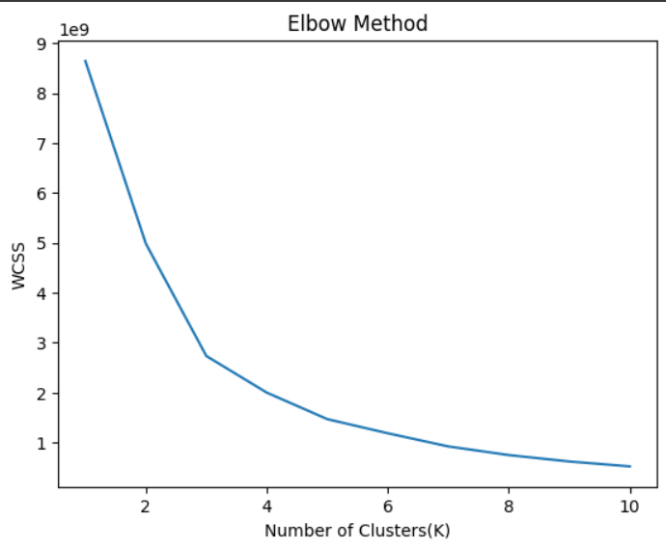
Elbow Method for calculating Optimum number of Clusters
We use the elbow method to figure out the optimum number of clusters, in which we plot WCSS on y-axis for all values of K from 1-10. We get the following graph:

Slide 6
As we can observe from the plot, that After K=5, the WCSS decreases slowly. Thus, K=5 is the Optimum value for K.
Thus, we train the model then with K=5

Slide 7
Composition of each Cluster
Count of Elements in Cluster 1: 410
Count of Elements in Cluster 2: 6111
Count of Elements in Cluster 3: 105
Count of Elements in Cluster 4: 413
Count of Elements in Cluster 5: 11

Slide 8
Average values of metrics in each Cluster
Cluster 1:
Average Value of num_reaction: 1777.7073170731708
Average Value of num_comments: 114.21463414634147
Average Value of num_shares: 34.96829268292683
Cluster 2:
Average Value of num_reaction: 105.15987563410243
Average Value of num_comments: 44.72312223858616
Average Value of num_shares: 12.956635575192276

Slide 9
Cluster 3:
Average Value of num_reaction: 498.93333333333334
Average Value of num_comments: 5004.961904761904
Average Value of num_shares: 463.85714285714283
Cluster 4:
Average Value of num_reaction: 465.2857142857143
Average Value of num_comments: 1443.2445520581114
Average Value of num_shares: 323.4648910411622
Cluster 5:
Average Value of num_reaction: 571.1818181818181
Average Value of num_comments: 12727.09090909091
Average Value of num_shares: 577.0909090909091

Slide 10
Thank you

